Slide 1



mattise
senior
thesis
Notes:
Splash Screen Slide

Slide 2
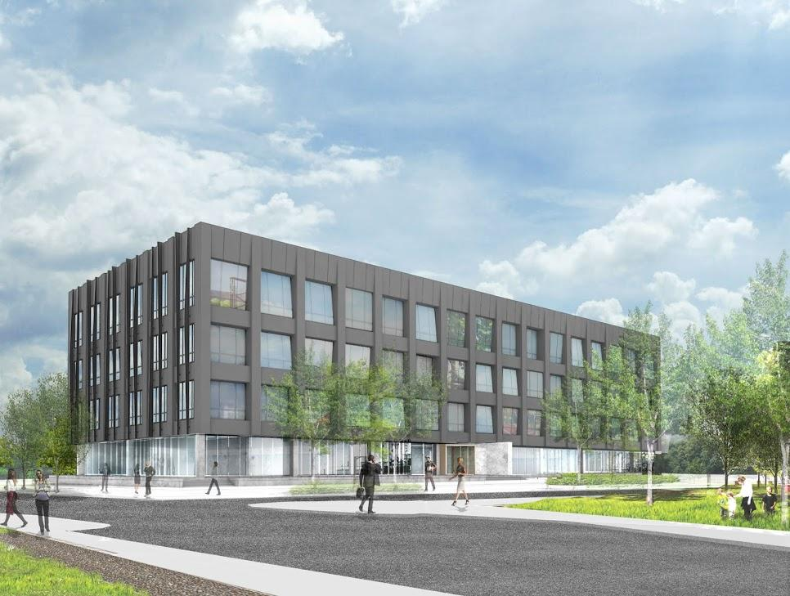
mattise
senior
thesis
201 Rouse
The Navy Yard
Philadelphia PA, 19112
advisor Dr. Laura Miller
Notes:
Title Slide

Slide 3
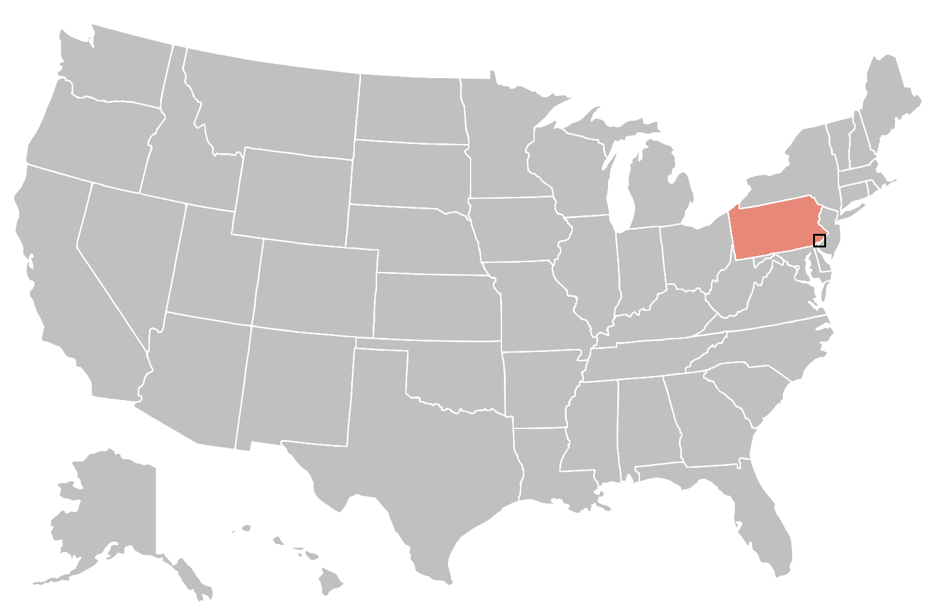
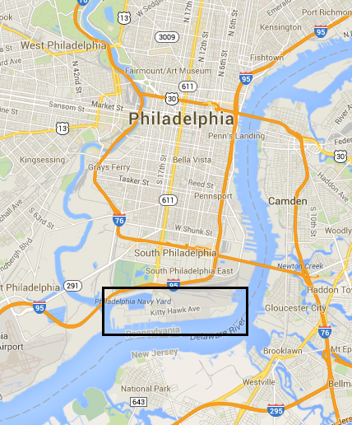
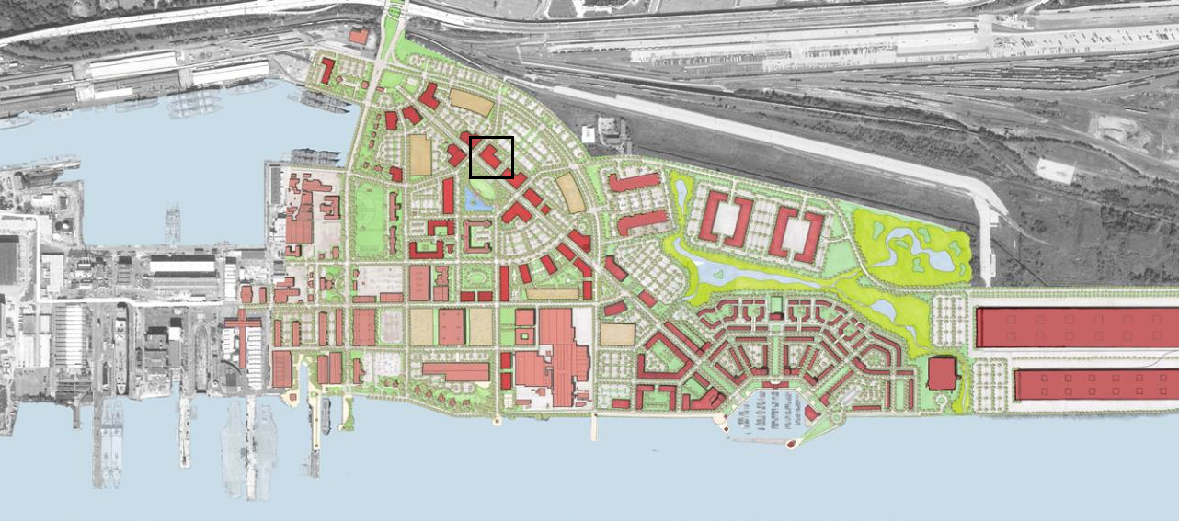
introduction
about 201 rouse
location
building statistics
existing systems
performance
thesis proposal
mechanical depth
electrical breadth
conclusion
Notes:
Location of 201 Rouse

Slide 4
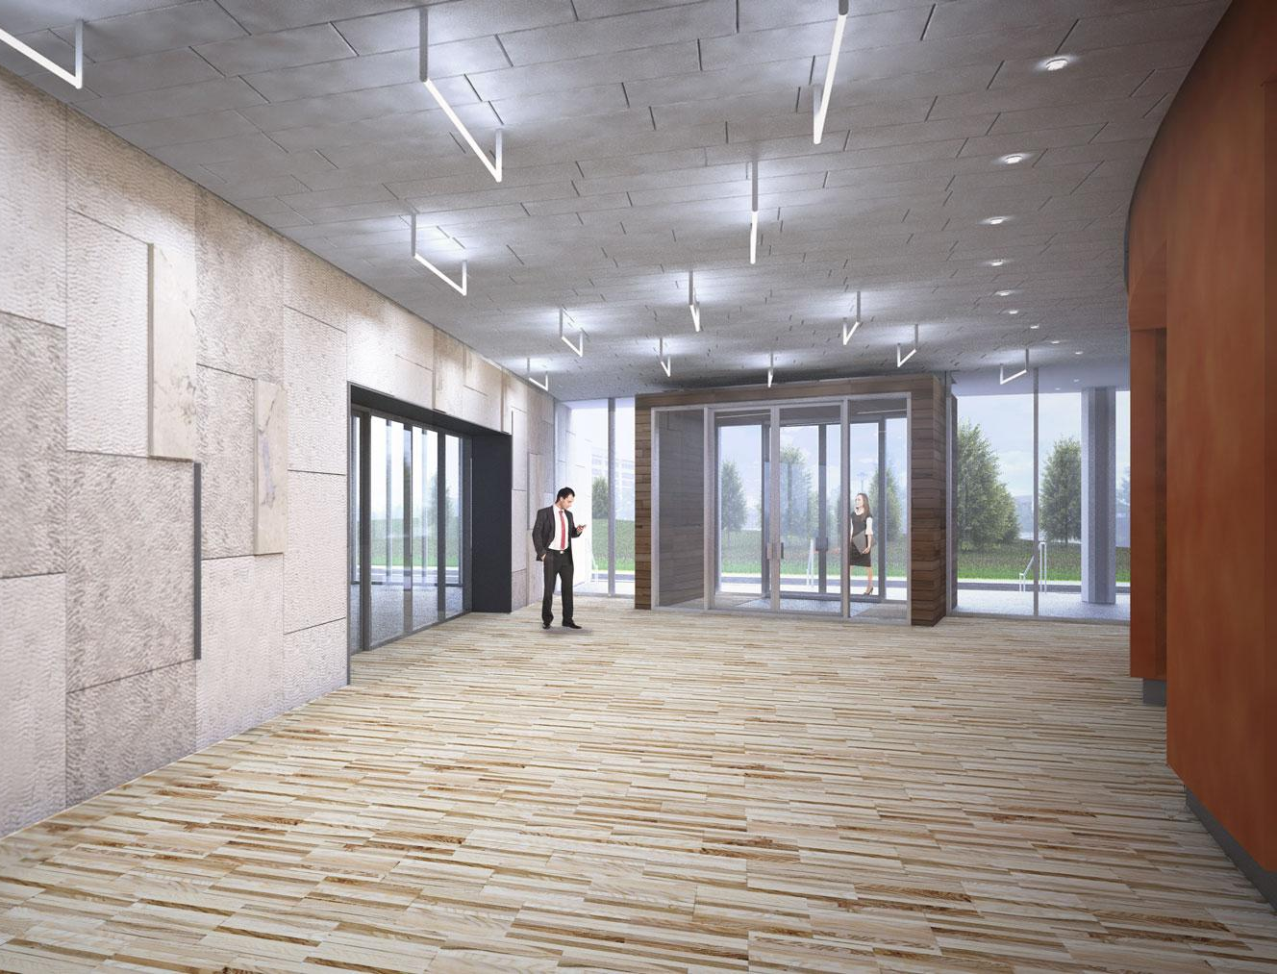
introduction
201 Rouse
84,500 square feet
4 stories
high end office space
Franklin Square Capital Partners
September 2013 to Q1 2015
$19.4 million
about 201 rouse
location
building statistics
existing systems
performance
thesis proposal
mechanical depth
electrical breadth
conclusion
Notes:
Statistics of 201 Rouse
Size
Function
Stories
Occupant
Construction Dates

Slide 5
introduction
architecture
zinc clad exterior facade
glass walled ground floor pedestal
floor to ceiling windows
premium materials
solar shading fins
about 201 rouse
location
building statistics
existing systems
performance
thesis proposal
mechanical depth
electrical breadth
conclusion
Notes:
existing mechanical system

Slide 6
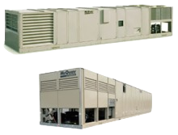
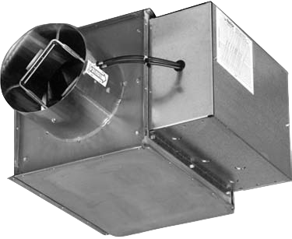
introduction
mechanical system
dual 125 ton packaged AHUs
67,200 CFM | 24% min OA
DX coil cooling | electric heating
two vertical risers for supply & return
4 sizes of VAV with reheat terminals
separate HVAC for restrooms and core
about 201 rouse
location
building statistics
existing systems
performance
Packaged Unit | Airflow (Max/Min) [SCFM] | Cooling Capacity (MBH) | Heating Capacity (MBH) | Unit Specified
1 & 2 | 33,600/8,230 | 1501.5 | 748.5 | McQuay RPS130D
3 | 1,600/165 | 48.6 | 65.5 | McQuay MHSH04B
thesis proposal
mechanical depth
Unit | Inlet Dia. (in) | Primary Air (Max/Min) (CFM) | Electric Reheat Coil Capacity (BTU/hr)
A | 6 | 420/210 | 10239
B | 8 | 800/400 | 20478
C | 10 | 1400/700 | 34310
D | 12 | 1800/900 | 42663
electrical breadth
conclusion
Notes:
Existing Systems:
Mechanical

Slide 7
introduction
building loads
electrical plug density - 0.75 W/ft²
lighting intensity - 1.0 W/ft²
task lighting - 0.75 W/ft²
equipment density - 0.229 W/ft²
HVAC - 0.709 W/ft²
design conditions
outdoor
summer - 90.6ºF dry bulb
summer - 74.3 ºF wet bulb
winter - 16.9ºF
indoor
cooling - 75ºF
heating - 70ºF
54% relative humidity
about 201 rouse
location
building statistics
existing systems
performance
thesis proposal
mechanical depth
electrical breadth
conclusion
Notes:
Statistics of 201 Rouse
Size
Function
Stories
Occupant
Construction Dates

Slide 8
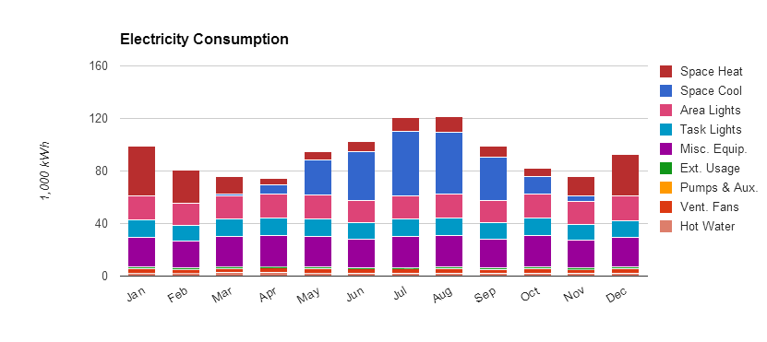
introduction
building performance
envelope driven performance
HVAC is 36% of annual electricity usage
all electric equipment | uniform demand rate
$181,191 yearly utility cost
31% EUI performance gain
about 201 rouse
location
building statistics
existing systems
performance
thesis proposal
mechanical depth
electrical breadth
conclusion
Notes:
Statistics of 201 Rouse
Size
Function
Stories
Occupant
Construction Dates

Slide 9
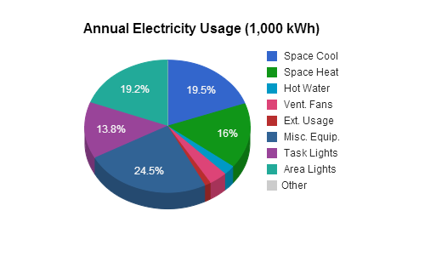
introduction
building performance
envelope driven performance
HVAC is 36% of annual electricity usage
all electric equipment | uniform demand rate
$181,191 yearly utility cost
31% EUI performance gain
about 201 rouse
location
building statistics
existing systems
performance
thesis proposal
mechanical depth
electrical breadth
conclusion
Notes:
building performance slide 2
mechanical % of utility use

Slide 10
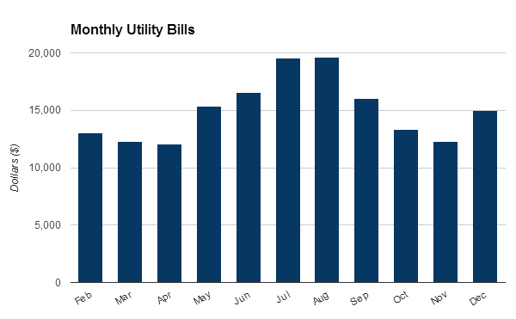
introduction
building performance
envelope driven performance
HVAC is 36% of annual electricity usage
all electric equipment | uniform demand rate
$181,191 yearly utility cost
31% EUI performance gain
about 201 rouse
location
building statistics
existing systems
performance
thesis proposal
mechanical depth
electrical breadth
conclusion
Notes:
performance slide 3
yearly utility cost

Slide 11
introduction
building performance
envelope driven performance
HVAC is 36% of annual electricity usage
all electric equipment | uniform demand rate
$181,191 yearly utility cost
31% EUI performance gain
about 201 rouse
location
building statistics
existing systems
performance
Building | Site EUI (kBtu/sqft) | Source EUI (kBtu/sqft) | Performance Gain
201 Rouse | 46.4 | 139.2 | 31% Site 6% Source
CBECS National Average | 67.3 | 148.1 | -
thesis proposal
mechanical depth
electrical breadth
conclusion
Notes:
performance slide 4
EUI and Comparison

Slide 12
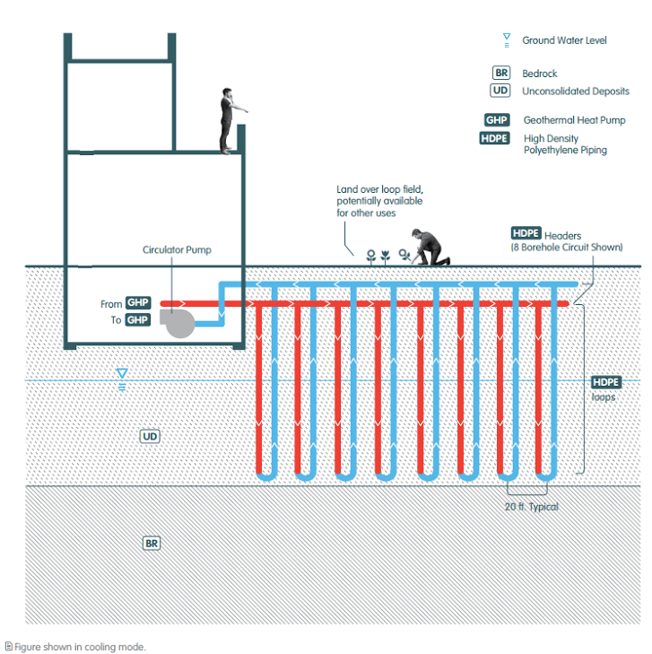
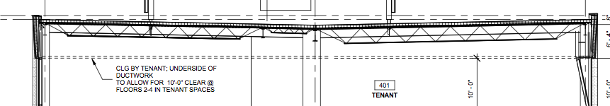
mechanical depth
structural breadth
introduction
geothermal heat pumps
active chilled beams
dedicated outdoor air
analyze roof structural support
about 201 rouse
thesis proposal
mechanical depth
goals
electrical breadth
electrical breadth
testbed of geothermal application
lower annual energy use
increase LEED rating
electrical equipment and wires for new HVAC equipment
conclusion
Notes:
Location of 201 Rouse
Small Map of USA with cutout of Philadelphia and Block of South Philly
Navy Yard Master Plan image of site

Slide 13
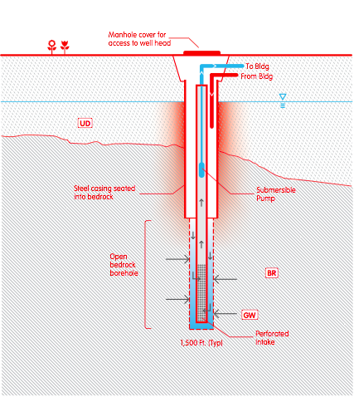
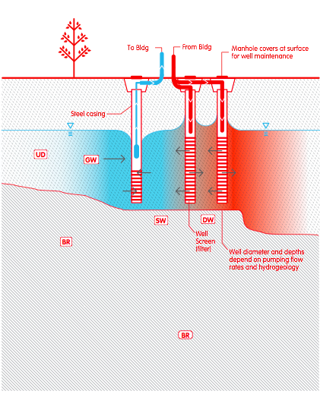
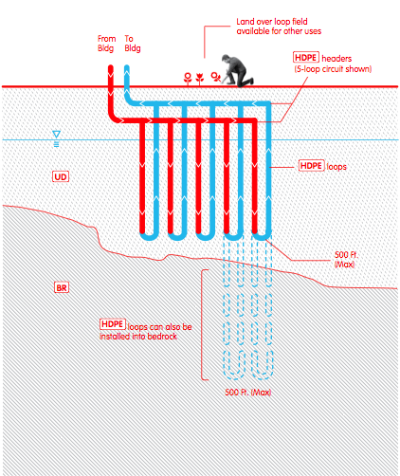
introduction
about 201 rouse
standing column well
open loop
closed loop
thesis proposal
mechanical depth
selection
geothermal calculations
well layout
equipment
dedicated outdoor air system
active chilled beams
performance
electrical breadth
conclusion

Slide 14
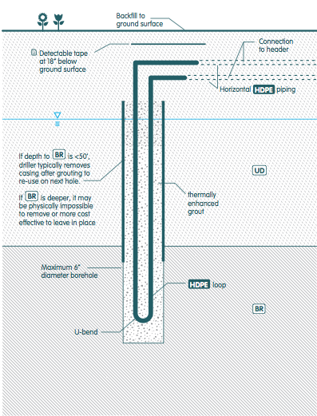
introduction
about 201 rouse
closed loop
ground coupled heat pump
constant thermal properties
reduced pump energy
lowest level of maintenance
maintains usable site space
expensive
thesis proposal
mechanical depth
selection
geothermal calculations
well layout
equipment
dedicated outdoor air system
active chilled beams
performance
electrical breadth
conclusion

Slide 15
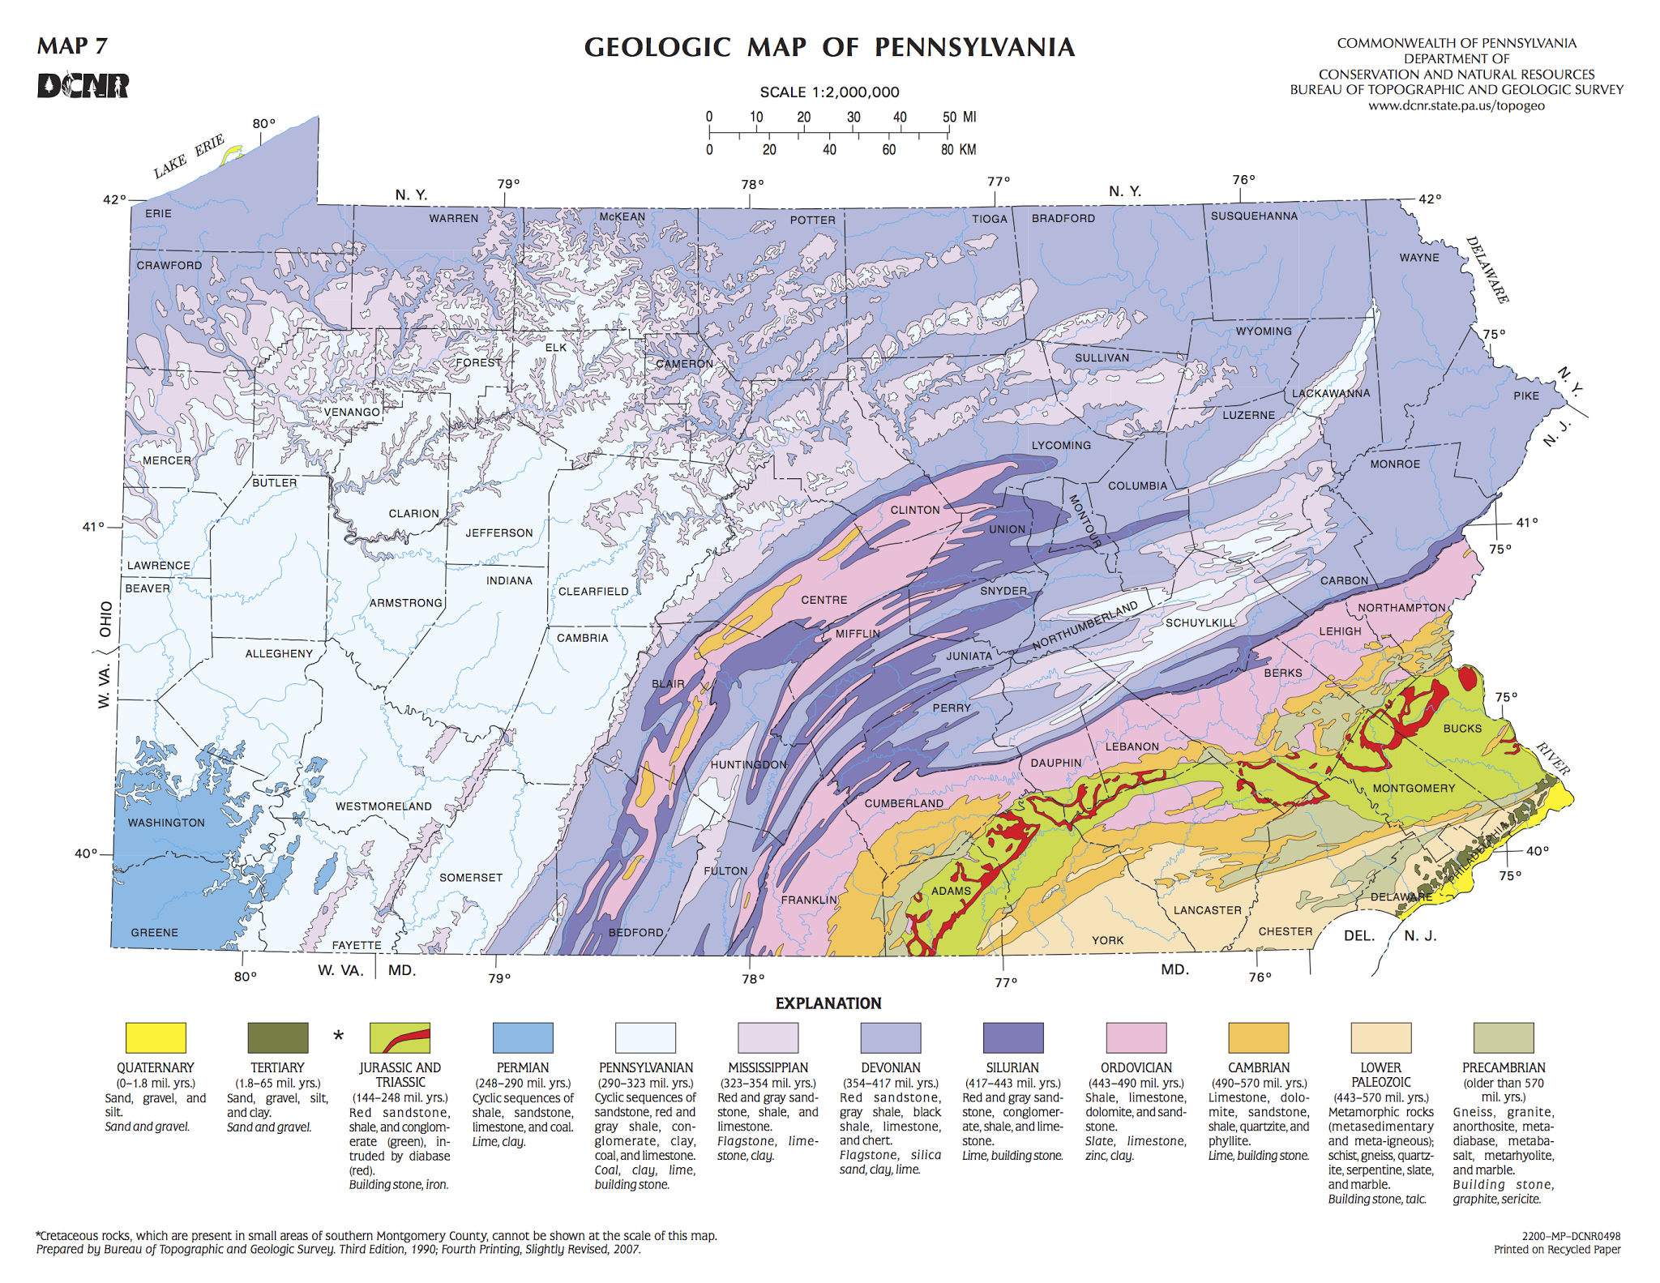
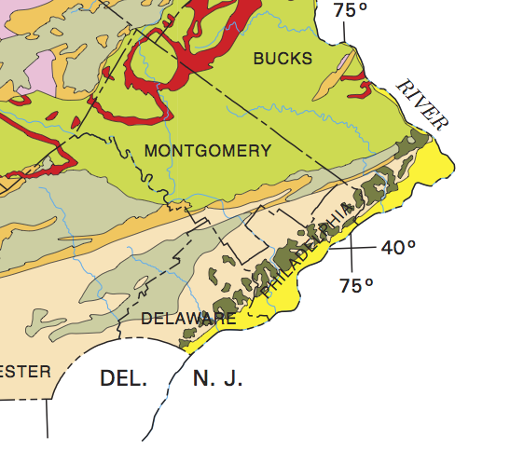
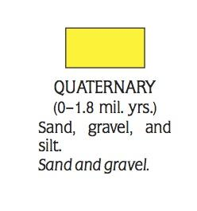
introduction
about 201 rouse
site characteristics
bedrock mix of sand and gravel
conductivity of 1.6 Btu/hr*ft*ºF
constant ground temperature of 55ºF
long term thermal performance with diffusivity and Potomac-Raritan-Magothy aquifer penetration
thesis proposal
mechanical depth
selection
geothermal calculations
well layout
equipment
dedicated outdoor air system
active chilled beams
performance
electrical breadth
conclusion

Slide 16
introduction
about 201 rouse
Ingersoll and Zobel Bore Length Equations
 | Cooling | Heating | Units
Short Circuit Heat Loss Factor, Fsc | 1.04 | 1.04 | -
Part Load Factor , PFLm | 1.00 | 1.00 | -
Net annual heat transfer to ground, Qa | 700,000 | 700,000 | btu/hr
Building Design Block Load Cooling, Qlc | 3,000,000 | - | btu/hr
Building Design Block Load Heating, Qlh | - | 2,300,000 | btu/hr
Effective thermal resistance of ground annual pulse, Rga | 0.24 | 0.24 | ft*hr*^{O}F / Btu
Effective thermal resistance of ground daily pulse, Rgd | 0.13 | 0.13 | ft*hr*^{O}F / Btu
Effective thermal resistance of ground monthly pulse, Rgm | 0.21 | 0.21 | ft*hr*^{O}F / Btu
Effective thermal resistance of bore, Rb | 0.10 | 0.10 | ft*hr*^{O}F / Btu
Undisturbed ground Temperature, tg | 55.00 | 55.00 | ^{O}F
Temp penalty for interference of adjacent bores, tp | 2.00 | 2.00 | ^{O}F
Liquid temp at HP inlet, twi | 75.00 | 35.00 | ^{O}F
Liquid temp at HP outlet, two | 85.90 | 30.00 | ^{O}F
System power input at design cooling load, Wc | 100,000 | - | W
System power input at design heating load, Wh | - | 100,000 | W
Required Length | 48,617 | 50,096 | ft
well sizing
bedrock mix of sand and gravel
conductivity of 1.6 Btu/hr*ft*ºF
constant ground temperature of 55ºF
long term thermal performance with diffusivity and Potomac-Raritan-Magothy aquifer penetration
thesis proposal
mechanical depth
selection
geothermal calculations
well layout
equipment
dedicated outdoor air system
active chilled beams
performance
electrical breadth
conclusion
Notes:
geothermal well sizing

Slide 17
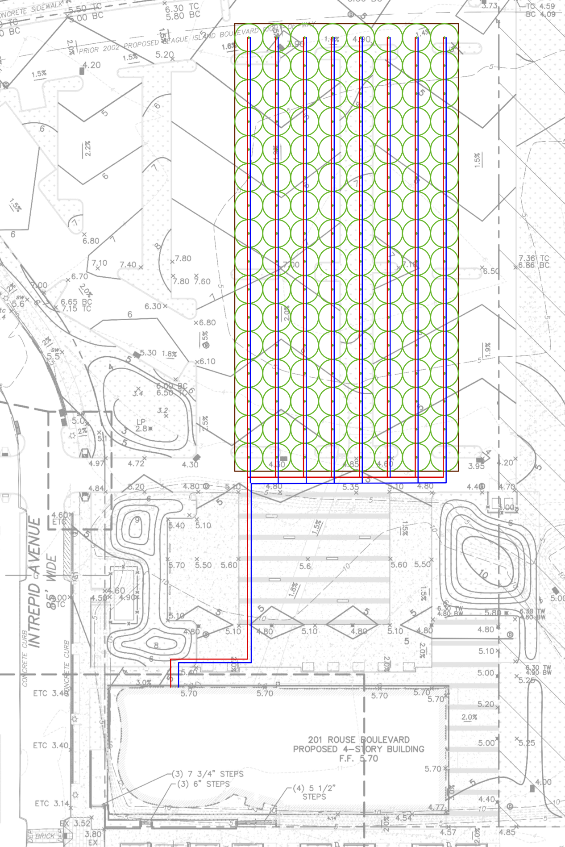
introduction
about 201 rouse
well layout
grid of 8x16 wells
128 wells
400 foot well depth
20 ft well spacing
surface area of 51,200 ft²
reverse return piping setup
underneath 201 rouse parking lot
thesis proposal
mechanical depth
selection
geothermal calculations
well layout
equipment
dedicated outdoor air system
active chilled beams
performance
electrical breadth
conclusion
Notes:
layout of geothermal wells

Slide 18
introduction
about 201 rouse
well layout
grid of 8x16 wells
128 wells
400 foot well depth
surface area of 51,200 ft²
reverse return piping setup
underneath 201 rouse parking lot
thesis proposal
mechanical depth
selection
geothermal calculations
well layout
equipment
dedicated outdoor air system
active chilled beams
performance
electrical breadth
conclusion
Notes:
layout of geothermal wells

Slide 19
introduction
about 201 rouse
well layout
6” header pipe
2” row header pipe
1” thermally fused HDPE well piping
6” bore diameter
thermally conductive fill material
thesis proposal
mechanical depth
selection
geothermal calculations
well layout
equipment
dedicated outdoor air system
active chilled beams
performance
electrical breadth
conclusion
Notes:
layout of geothermal wells and piping information

Slide 20
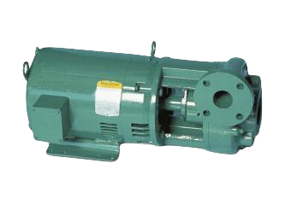
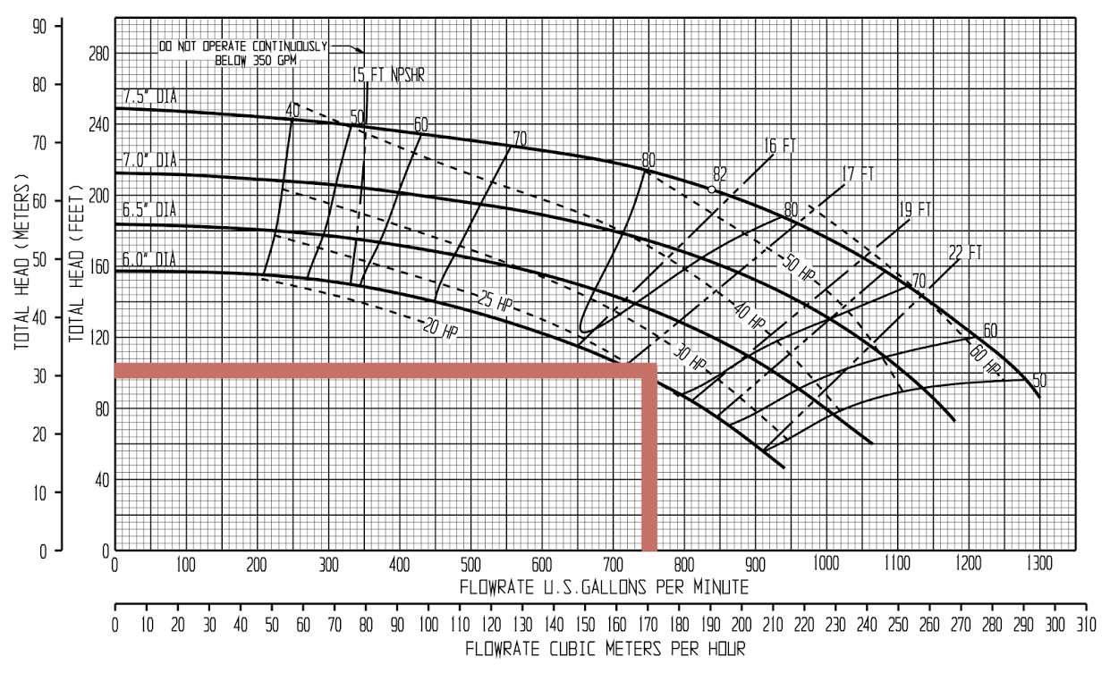
introduction
about 201 rouse
well field pump
3 GPM/ton design flow
750 GPM pipe requirement
96 feet head loss
25 bhp pump operating at 2,700 RPM
thesis proposal
mechanical depth
selection
geothermal calculations
well layout
equipment
dedicated outdoor air system
active chilled beams
performance
Section | Pipe Size (in) | Head Loss
Header | 6.00 | 18.75
Bore Loop | 2.00 | 21.51
Well | 1.00 | 23.47
Sub Total | - | 63.73
Multiplier |  | 1.50
Total |  | 95.59
electrical breadth
conclusion
Notes:
Head Calc and Pump selection

Slide 21
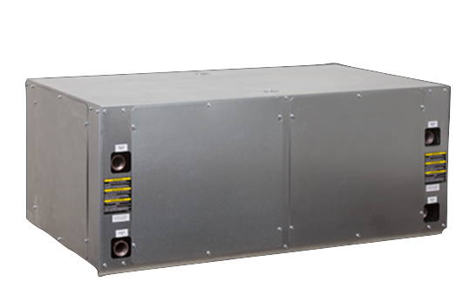
introduction
about 201 rouse
heat pump
20 ton water to water units
iterative design between delta T of heat pump and well requirements
13 total units
laid out on roof
247 tons cooling | 342 ft²/ton cooling
2,352 Mbtu heating | 431 ft²/ton heating
thesis proposal
mechanical depth
selection
geothermal calculations
well layout
equipment
dedicated outdoor air system
active chilled beams
performance
heating
Source |  |  | Load
EWT (deg F) | Flow (GPM) | Head Loss | EWT | Source LWT | HC (MBtuh) | Power (kW) | HA (MBtuh) | LWT | COP | Head Loss
35 | 50 | 9.9 | 110 | 30.3 | 180.9 | 18.9 | 116.4 | 117.2 | 2.8 | 7.4
cooling
Source |  |  | Load
EWT (ºF) | Flow (GPM) | Head Loss | EWT | Source LWT (ºF) | TC (MBH) | Power (kW) | HR (MBH) | LWT (ºF) | EER | Head Loss
75 | 50 | 6.75 | 57 | 85.9 | 228.8 | 12.52 | 271.55 | 50.85 | 18.35 | 8.4
electrical breadth
conclusion
Notes:
heat pump selection

Slide 22
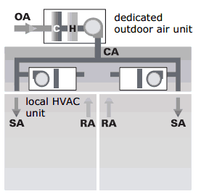
introduction
about 201 rouse
dedicated outdoor air system (DOAS)
handles air ventilation requirement and space latent loads
increases indoor air quality (IAQ)
60% relative humidity for spaces
downsizes air flow requirements for space conditioning
delivers conditioned “cold” air directly to the active chilled beams
reduces duct size
thesis proposal
mechanical depth
selection
geothermal calculations
well layout
equipment
dedicated outdoor air system
active chilled beams
performance
electrical breadth
conclusion
Notes:
DOAS intro

Slide 23
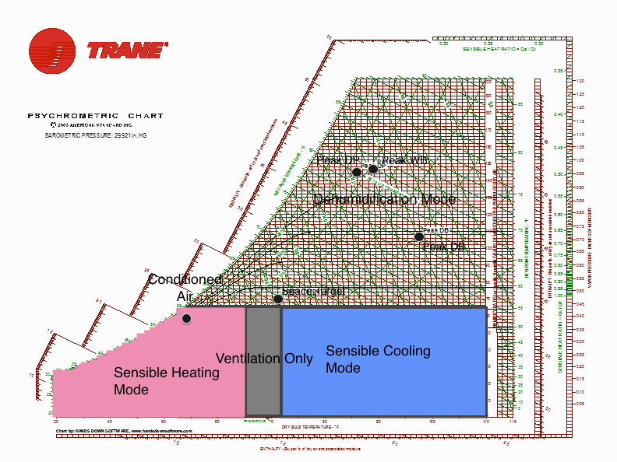
introduction
about 201 rouse
dedicated outdoor air system (DOAS)
sized based upon ACBs and peak wet bulb
12,500 CFM
73 tons cooling | chilled water from GCHP
hot water sensible heating
thesis proposal
mechanical depth
selection
geothermal calculations
well layout
equipment
dedicated outdoor air system
active chilled beams
performance
Space | # of Typical | Latent Load
WNW (office) | 4 | 7.45 kBtu/hr
SE (office) | 4 | 11.4 kBtu/hr
Total | 8 | 75,400 Btu/hr
electrical breadth
conclusion
Notes:
DOAS control and sizing

Slide 24
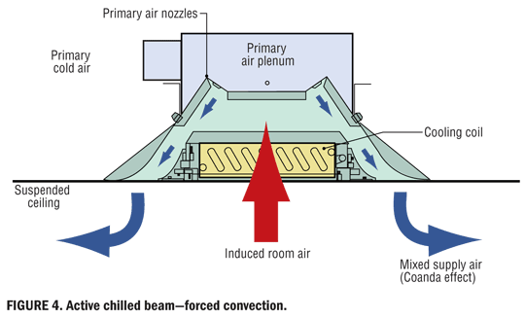
introduction
about 201 rouse
active chilled beams (ACB)
active chilled beams are effective at cooling large spaces at low primary airflow rates
coupled with a “cold” primary air DOAS unit saves on required ACB capacity
required airflow for ACB must be sufficient to maintain latent load of space to avoid condensate
thesis proposal
mechanical depth
selection
geothermal calculations
well layout
equipment
dedicated outdoor air system
active chilled beams
performance
electrical breadth
conclusion
Notes:
ACB intro

Slide 25
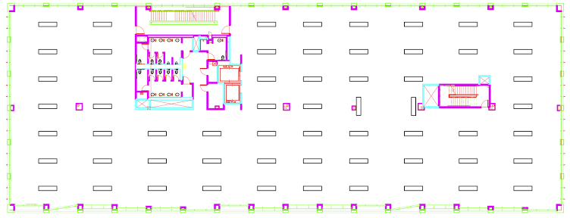
introduction
about 201 rouse
active chilled beams (ACB)
selected Trox 8ft active chilled beam
covers an area of 300 ft²
requires 60 per floor to condition space
thesis proposal
mechanical depth
selection
geothermal calculations
well layout
equipment
dedicated outdoor air system
active chilled beams
performance
Selected ACB | V | Qcw | Qh | GPM | Head Loss
8 ft DID632 Z Nozzle | 50 CFM | 4,305 Btu/hr | 7,803 Btu/hr | 1 | 5.8 ft H20
Space | # ACBs | Airflow | Sensible Cooling | Heating | GPM
SE | 26 | 1,300 CFM | 112.3 kBtu/hr | 202 kBtu/hr | 26
WNW | 34 | 1,700 CFM | 146 kBtu/hr | 265 kBtu/hr | 34
Total | 60 | 2,950 CFM | 258.3 kBtu/hr | 467 kBtu/hr | 60
electrical breadth
conclusion
Notes:
ACBs continued

Slide 26
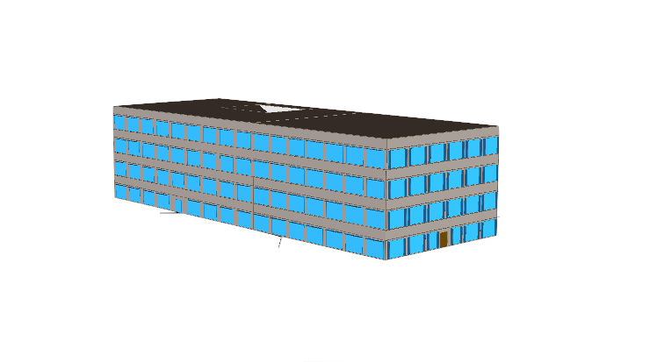
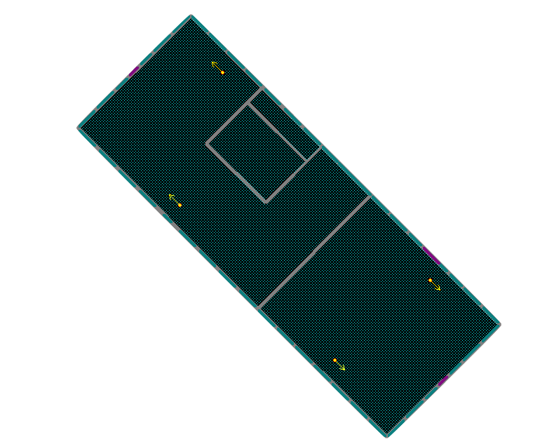
introduction
about 201 rouse
energy modeling complexities
with the complexity of the designed system modeling was a hurdle
accurate modeling of advanced HVAC systems is limited by the components that different modeling programs support
many solutions do not offer all three components or they are not fully realized
ended up using eQUEST
thesis proposal
mechanical depth
selection
geothermal calculations
well layout
equipment
dedicated outdoor air system
active chilled beams
performance
electrical breadth
conclusion
Notes:
Modeling Complexities

Slide 27
introduction
about 201 rouse
geothermal model
ground source vertical well system
water to air heat pumps based upon water to water HP capacity
packaged fan unit based upon DOAS unit fan CFM and energy performance
yields an energy model representative of the designed system’s energy use
powered induction unit model
uses powered induction units
packaged fan unit sized to the DOAS unit
but induction units are supplied HW and CHW by boiler and cooling tower respectively
creates a representative model of building thermal performance
thesis proposal
mechanical depth
selection
geothermal calculations
well layout
equipment
dedicated outdoor air system
active chilled beams
performance
electrical breadth
conclusion
Notes:
Modeling Solution

Slide 28
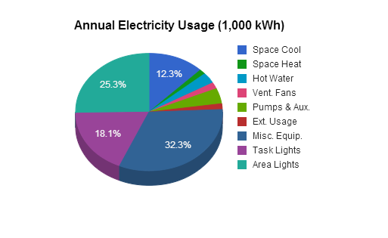
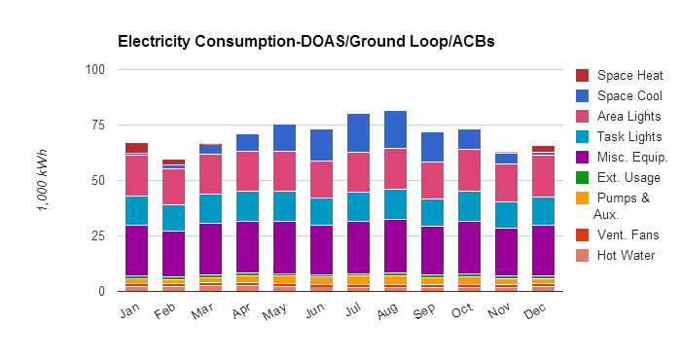
introduction
about 201 rouse
monthly performance
annual energy usage
thesis proposal
mechanical depth
selection
geothermal calculations
well layout
equipment
dedicated outdoor air system
active chilled beams
performance
electrical breadth
conclusion
Notes:
Energy Results

Slide 29
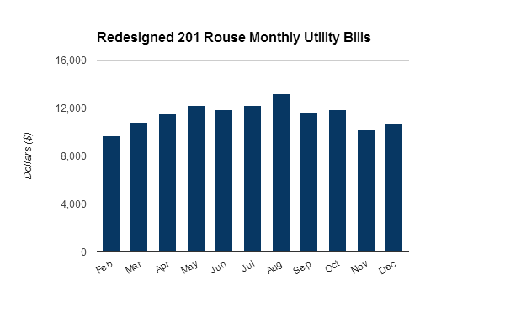
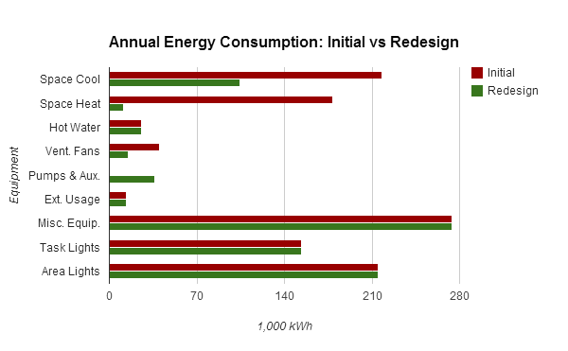
introduction
about 201 rouse
monthly utility cost
energy comparison
saves 270,000 kWh
thesis proposal
mechanical depth
selection
geothermal calculations
well layout
equipment
dedicated outdoor air system
active chilled beams
performance
electrical breadth
conclusion
Notes:
Energy Results

Slide 30
introduction
about 201 rouse
cost comparison
new HVAC system cost
thesis proposal
Component | Unit Cost | Unit | Units | Cost
Heat Pumps | $41,387 | each | 13 | $538,031
Geothermal Wells and Headers | $16 | per foot | 51200 | $819,200
DOAS | $209,958 | each | 1 | $209,958
Ducts | $12.82 | linear foot | 2800 | $35,896.00
Return Grills | $30.02 | each | 120 | $3,602.40
Building Side Pumps | $10,163 | each | 2 | $20,326
Well Field Pumps | $21,050 | each | 2 | $42,100
Core HVAC Unit | $14.90 | sqft | 5312 | $79,148.80
Active Chilled Beams | $1,404 | each | 240 | $336,960
Piping | $16.35 | linear foot | 6600 | $107,910.00
Total |  |  |  | $2,193,132
mechanical depth
selection
geothermal calculations
well layout
equipment
dedicated outdoor air system
active chilled beams
performance
Building | Mechanical Systems Cost | Total Building Cost | Mechanical %
201 Rouse Initial | $1,513,000 | $19,402,000 | 7.80%
201 Rouse Thesis Revised | $2,193,132 | $20,082,132 | 10.92%
Difference | - | $680,132 | 3.12%
electrical breadth
conclusion
Notes:
Energy Results

Slide 31
introduction
about 201 rouse
payback period
saves on average $3,600 a month in utility bills
187 months | 15.5 years
using uniform electricity charge of $0.162 per kWh
EUI comparison
thesis proposal
mechanical depth
selection
geothermal calculations
well layout
equipment
dedicated outdoor air system
active chilled beams
performance
Building | Site EUI (kBtu/sqft) | Source EUI (kBtu/sqft) | Performance Gain Over Benchmark | Performance Gain over Initial
201 Rouse Initial | 46.4 | 139.2 | 31% Site, 6% Source | -
201 Rouse Redesigned | 35.2 | 105.6 | 48% Over Site, 28% Source | 24% Site, 24% Source
CBECS National Average | 67.3 | 148.1 | - | -
electrical breadth
conclusion
Notes:
Energy Results

Slide 32


introduction
about 201 rouse
initial LEED certification standing
seeking LEED new construction certification
as of October 2013 the building only qualified for 54 of the 110 LEED points
owner’s goal was gold
silver is 50-59
gold threshold is 60
revised LEED certification standing
the geothermal system reaffirmed 3 points for “green power”
the DOAS added 1 LEED point for indoor air quality
the whole building energy reduction yield an additional 10 points
new LEED score | 65
thesis proposal
mechanical depth
selection
geothermal calculations
well layout
equipment
dedicated outdoor air system
active chilled beams
performance
electrical breadth
conclusion
Notes:
LEED Upgrade

Slide 33
introduction
existing electrical system
electrical utility via PECO and local microgrid
600 amp high voltage connection
4000 amp main distribution board (mdb)
~1650 FLA of existing and future HVAC equipment
removed electrical loads
~1650 full load amps removed from mdb
about 201 rouse
Equipment | Quantity | Full Load Amps | MCA | Volts | Phase | KW
Rooftop Air Handling Unit | 2 | 369.2 | 400 | 460 | 3 | 294.2
VAV-A | 8 | 10.83032491 | 15 | 277 | 1 | 3
VAV-B | 8 | 21.66064982 | 25 | 277 | 1 | 6
VAV-C | 8 | 36.10108303 | 40 | 277 | 1 | 10
VAV-D | 8 | 45.12635379 | 50 | 277 | 1 | 12.5
Total |  | 1648.147292 | 1840 |  |  | 840.4
thesis proposal
mechanical depth
electrical breadth
existing
new loads
panel boards
conclusion
Notes:
Electrical Breadth

Slide 34
introduction
new electrical wiring
new electrical loads
~540 full load amps added to mdb
about 201 rouse
Equipment | Quantity | Full Load Amps | MCA | Voltage | Phase | KW
Well Field Pump | 2 | 23.3 | 30 | 460 | 1 | 18.6
Heat Pump | 13 | 33.4 | 40 | 460 | 3 | 18.9
Hot/Chilled Water Pump | 4 | 4.04 | 15 | 230 | 1 | 1.12
DOAS Unit | 1 | 37.8 | 50 | 460 | 3 | 37.8
Equipment | Quantity | Amps | Wire Type | Wires | Wire Size | Ground Size | Conduit
Well Field Pump | 2 | 23.3 | THHW | 3 Current 1 Neutral 1 Ground | 10 AWG | 14 AWG | 1" EMT
Heat Pump | 13 | 22.73 | THHW | 3 Current 1 Neutral 1 Ground | 10 AWG | 14 AWG | (3) 1 1/2" EMT
Hot/Chilled Water Pump | 4 | 4.04 | THHW | 1 Current 1 Neutral 1 Ground | 14 AWG | 14 AWG | 1" EMT
DOAS Unit | 1 | 37.8 | THHW | 3 Current 1 Neutral 1 Ground | 8 AWG | 12 AWG | 3/4" EMT
Panelboard HVH1 | 1 | 350 | THHW | 3 Current 1 Neutral 1 Ground | (2) 2/0 AWG | 4 AWG | 2" EMT
thesis proposal
mechanical depth
electrical breadth
existing
new loads
panel boards
conclusion
Notes:
Electrical Breadth

Slide 35
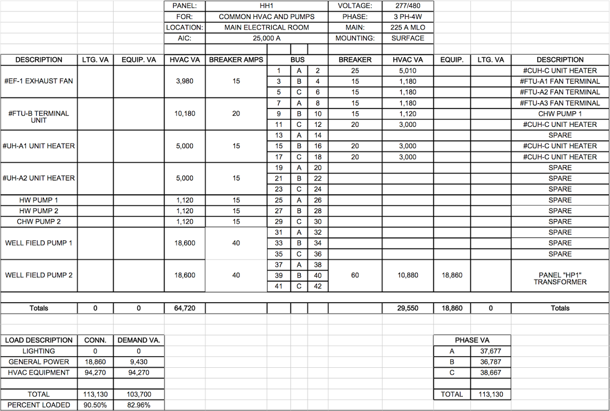
introduction
electrical breadth
removal of 1,100 full load amps from main distribution
no change in panel quantity
circuit location optimized to equipment
reduction in wiring costs
owner choice between electrical panel savings or additional future capacity
new panelboard
about 201 rouse
thesis proposal
mechanical depth
electrical breadth
existing
new loads
panel boards
conclusion
Notes:
Electrical Breadth

Slide 36
introduction
conclusion
GCHP | DOAS | ACB
costs $680,000
24% EUI reduction
$3,600 average monthly savings
15.5 year payback for HVAC system
electrical panel savings or future capacity
LEED gold
about 201 rouse
thesis proposal
mechanical depth
electrical breadth
conclusion
Notes:
Conclusion

Slide 37
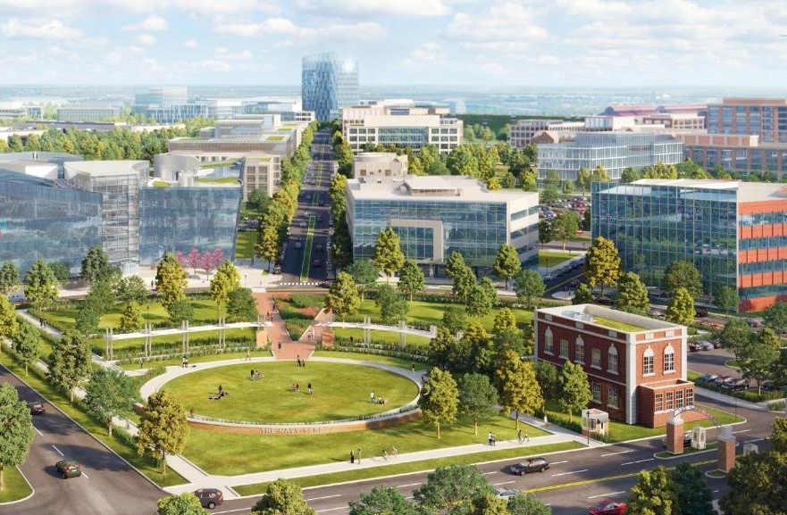
introduction
acknowledgements
Liberty Property Trust
Turner Construction
In Posse
Dr. Laura Miller
Penn State University
friends | family | co-workers
about 201 rouse
thesis proposal
mechanical depth
electrical breadth
conclusion
Notes:
Acknowledgements

Slide 38
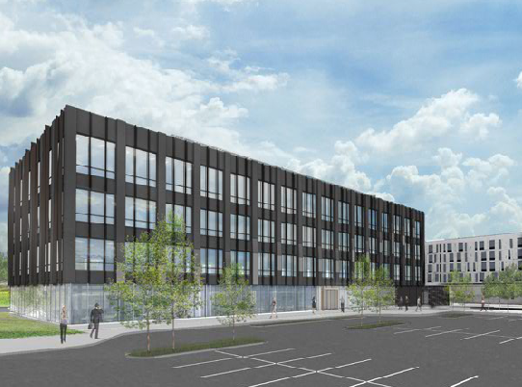
introduction
about 201 rouse
questions
thesis proposal
mechanical depth
electrical breadth
recommendations
conclusion
Notes:
Questions
Recommendations

